Slide 1
Probabilistic Information Retrieval
Christopher Manning and Pandu Nayak

Slide 2
From Boolean to ranked retrieval … in two steps
Notes:
First step is just soft matching whether words are contained in documents or not.
Second step is putting in more accurate term weights using term frequency

Slide 3
Ranked retrieval
Ch. 6
Thus far, our queries have all been Boolean
Documents either match or don’t
Can be good for expert users with precise understanding of their needs and the collection
Can also be good for applications: Applications can easily consume 1000s of results
Not good for the majority of users
Most users incapable of writing Boolean queries
Or they are, but they think it’s too much work
Most users don’t want to wade through 1000s of results.
This is particularly true of web search

Slide 4
Problem with Boolean search: feast or famine
Ch. 6
Boolean queries often result in either too few (=0) or too many (1000s) results.
Query 1: “standard user dlink 650” → 200,000 hits
Query 2: “standard user dlink 650 no card found”: 0 hits
It takes a lot of skill to come up with a query that produces a manageable number of hits.
AND gives too few; OR gives too many
Notes:
Cf. our discussion of how Westlaw Boolean queries didn’t actually outperform free text querying
First step is just soft matching whether words are contained in documents or not.
Second step is putting in more accurate term weights using term frequency

Slide 5



Who are these people?
Karen Spärck Jones
Stephen Robertson
Keith van Rijsbergen

Slide 6
Why probabilities in IR?
User
Information Need
Query
Representation
Understanding
of user need is
uncertain
How to match?
Document
Representation
Uncertain guess of
whether document has relevant content
Documents
In traditional IR systems, matching between each document and
query is attempted in a semantically imprecise space of index terms.
Probabilities provide a principled foundation for uncertain reasoning.
Can we use probabilities to quantify our uncertainties?

Slide 7
Probabilistic IR topics
Classical probabilistic retrieval model
Probability ranking principle, etc.
Binary independence model (≈ Naïve Bayes text cat)
(Okapi) BM25
Bayesian networks for text retrieval
Language model approach to IR
An important emphasis in recent work
Probabilistic methods are one of the oldest but also one of the currently hot topics in IR
Traditionally: neat ideas, but didn’t win on performance
It seems to be different now

Slide 8
The document ranking problem
We have a collection of documents
User issues a query
A list of documents needs to be returned
Ranking method is the core of modern IR systems:
In what order do we present documents to the user?
We want the “best” document to be first, second best second, etc….
Idea: Rank by probability of relevance of the document w.r.t. information need
P(R=1|document_{i}, query)

Slide 9
Recall a few probability basics
For events A and B:
Bayes’ Rule
Odds:
Prior
Posterior

Slide 10
The Probability Ranking Principle
“If a reference retrieval system’s response to each request is a ranking of the documents in the collection in order of decreasing probability of relevance to the user who submitted the request, where the probabilities are estimated as accurately as possible on the basis of whatever data have been made available to the system for this purpose, the overall effectiveness of the system to its user will be the best that is obtainable on the basis of those data.”
[1960s/1970s] S. Robertson, W.S. Cooper, M.E. Maron; van Rijsbergen (1979:113); Manning & Schütze (1999:538)

Slide 11
Probability Ranking Principle
Let x represent a document in the collection.
Let R represent relevance of a document w.r.t. given (fixed)
query and let R=1 represent relevant and R=0 not relevant.
Need to find p(R=1|x) – probability that a document x is relevant.
p(R=1),p(R=0) - prior probability
of retrieving a relevant or non-relevant
document
p(x|R=1), p(x|R=0) - probability that if a relevant (not relevant) document is retrieved, it is x.

Slide 12
Probability Ranking Principle (PRP)
Simple case: no selection costs or other utility concerns that would differentially weight errors
PRP in action: Rank all documents by p(R=1|x)
Theorem: Using the PRP is optimal, in that it minimizes the loss (Bayes risk) under 1/0 loss
Provable if all probabilities correct, etc. [e.g., Ripley 1996]

Slide 13
Probability Ranking Principle
More complex case: retrieval costs.
Let d be a document
C – cost of not retrieving a relevant document
C’ – cost of retrieving a non-relevant document
Probability Ranking Principle: if
for all d’ not yet retrieved, then d is the next document to be retrieved
We won’t further consider cost/utility from now on

Slide 14
Probability Ranking Principle
How do we compute all those probabilities?
Do not know exact probabilities, have to use estimates
Binary Independence Model (BIM) – which we discuss next – is the simplest model
Questionable assumptions
“Relevance” of each document is independent of relevance of other documents.
Really, it’s bad to keep on returning duplicates
Boolean model of relevance
That one has a single step information need
Seeing a range of results might let user refine query

Slide 15
Probabilistic Retrieval Strategy
Estimate how terms contribute to relevance
How do other things like term frequency and document length influence your judgments about document relevance?
Not at all in BIM
A more nuanced answer is the Okapi (BM25) formulae [next time]
Spärck Jones / Robertson
Combine to find document relevance probability
Order documents by decreasing probability
Notes:
In addition to the “document independence assumption” on previous slide, we have a “term independence assumption”: terms’ contributions to relevance are treated as independent events.
Okapi is one particular way of estimating probability given tf, df, and length.

Slide 16
Probabilistic Ranking
Basic concept:
“For a given query, if we know some documents that are relevant, terms that occur in those documents should be given greater weighting in searching for other relevant documents.
By making assumptions about the distribution of terms and applying Bayes Theorem, it is possible to derive weights theoretically.”
Van Rijsbergen
Notes:
Coming up with term weights

Slide 17
Binary Independence Model
Traditionally used in conjunction with PRP
“Binary” = Boolean: documents are represented as binary incidence vectors of terms (cf. IIR Chapter 1):
iff term i is present in document x.
“Independence”: terms occur in documents independently
Different documents can be modeled as the same vector

Slide 18
Binary Independence Model
Queries: binary term incidence vectors
Given query q,
for each document d need to compute p(R|q,d).
replace with computing p(R|q,x) where x is binary term incidence vector representing d.
Interested only in ranking
Will use odds and Bayes’ Rule:

Slide 19
Binary Independence Model
Constant for a given query
Needs estimation
Using Independence Assumption:

Slide 20
Binary Independence Model
Since x_{i} is either 0 or 1:
Let
Assume, for all terms not occurring in the query (q_{i}=0)

Slide 21
 | document | relevant (R=1) | not relevant (R=0)
term present | x_{i} = 1 | p_{i} | r_{i}
term absent | x_{i} = 0 | (1 – p_{i}) | (1 – r_{i})

Slide 22
Binary Independence Model
All matching terms
Non-matching query terms
All matching terms
All query terms
Notes:
Put all terms in query into right product and then divide through by them in left product.
Just go straight from the top to the bottom line with a multiply and a divide.

Slide 23
Binary Independence Model
Constant for
each query
Only quantity to be estimated
for rankings
Retrieval Status Value:

Slide 24
Binary Independence Model
All boils down to computing RSV.
The c_{i} are log odds ratios
They function as the term weights in this model
So, how do we compute c_{i}’s from our data ?
Notes:
Used to say: Linear Discriminant Function, because it is a linear function in terms of log probabilities, but maybe that’s too far afield for here, and is better discussed later

Slide 25
Binary Independence Model
Estimating RSV coefficients in theory
For each term i look at this table of document counts:
Estimates:
For now,
assume no
zero terms.
Remember
smoothing.
Notes:
p_i(1 – r_i) / r_i(1 - p_i) = denominators cancel out.
Log expression has numerators of p / (1 – p ) and denominators r / (1 – r).
Prabhakar wanted the add 0.5 explained. Here or elsewhere?
Log odds ratio. Add 0.5 to every expression

Slide 26
Estimation – key challenge
If non-relevant documents are approximated by the whole collection, then r_{i} (prob. of occurrence in non-relevant documents for query) is n/N and

Slide 27
Collection vs. Document frequency
Sec. 6.2.1
Collection frequency of t is the total number of occurrences of t in the collection (incl. multiples)
Document frequency is number of docs t is in
Example:
Which word is a better search term (and should get a higher weight)?
Word | Collection frequency | Document frequency
insurance | 10440 | 3997
try | 10422 | 8760
Notes:
Why do you get these numbers?
Suggests df is better.

Slide 28
Estimation – key challenge
p_{i} (probability of occurrence in relevant documents) cannot be approximated as easily
p_{i} can be estimated in various ways:
from relevant documents if you know some
Relevance weighting can be used in a feedback loop
constant (Croft and Harper combination match) – then just get idf weighting of terms (with p_{i}=0.5)
proportional to prob. of occurrence in collection
Greiff (SIGIR 1998) argues for 1/3 + 2/3 df_{i}/N

Slide 29
Probabilistic Relevance Feedback
Guess a preliminary probabilistic description of R=1 documents; use it to retrieve a set of documents
Interact with the user to refine the description: learn some definite members with R = 1 and R = 0
Re-estimate p_{i} and r_{i} on the basis of these
If i appears in V_{i} within set of documents V: p_{i} = |V_{i}|/|V|
Or can combine new information with original guess (use Bayesian prior):
Repeat, thus generating a succession of approximations to relevant documents
κ is
prior
weight
Notes:
explicit Bayesian smoothing with a prior

Slide 30
Iteratively estimating p_{i} and r_{i} (= Pseudo-relevance feedback)
Assume that p_{i} is constant over all x_{i} in query and r_{i} as before
p_{i} = 0.5 (even odds) for any given doc
Determine guess of relevant document set:
V is fixed size set of highest ranked documents on this model
We need to improve our guesses for p_{i} and r_{i}, so
Use distribution of x_{i} in docs in V. Let V_{i} be set of documents containing x_{i}
p_{i} = |V_{i}| / |V|
Assume if not retrieved then not relevant
r_{i} = (n_{i} – |V_{i}|) / (N – |V|)
Go to 2. until converges then return ranking

Slide 31
PRP and BIM
Getting reasonable approximations of probabilities is possible.
Requires restrictive assumptions:
Term independence
Terms not in query don’t affect the outcome
Boolean representation of documents/queries/relevance
Document relevance values are independent
Some of these assumptions can be removed
Problem: either require partial relevance information or seemingly only can derive somewhat inferior term weights

Slide 32
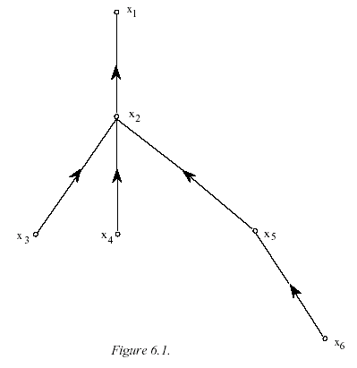
Removing term independence
In general, index terms aren’t independent
Dependencies can be complex
van Rijsbergen (1979) proposed simple model of dependencies as a tree
Exactly Friedman and Goldszmidt’s Tree Augmented Naive Bayes (AAAI 13, 1996)
Each term dependent on one other
In 1970s, estimation problems held back success of this model

Slide 33
Second step: Term frequency
Right in the first lecture, we said that a page should rank higher if it mentions a word more
Perhaps modulated by things like page length
We might want a model with term frequency in it.
We’ll see a probabilistic one next time – BM25
Quick summary of vector space model

Slide 34
Summary – vector space ranking
Represent the query as a weighted term frequency/inverse document frequency (tf-idf) vector
Represent each document as a weighted tf-idf vector
Compute the cosine similarity score for the query vector and each document vector
Rank documents with respect to the query by score
Return the top K (e.g., K = 10) to the user

Slide 35
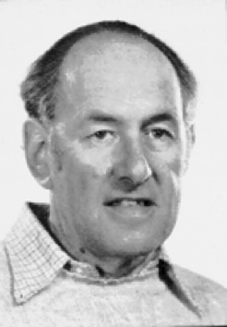
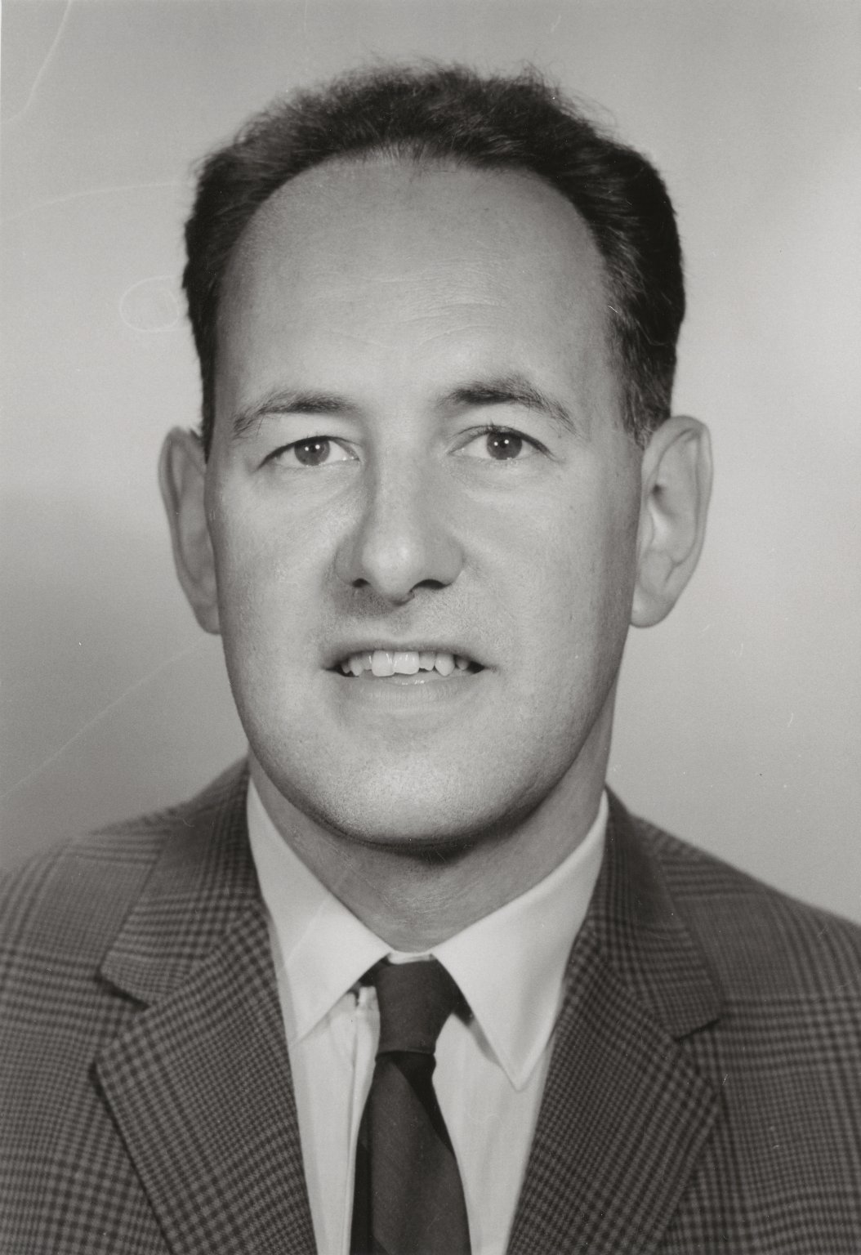
Notes:
Amit Singhal last of Gerard Salton

Slide 36
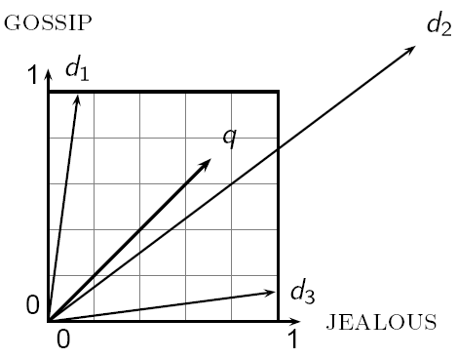
Cosine similarity
Sec. 6.3

Slide 37
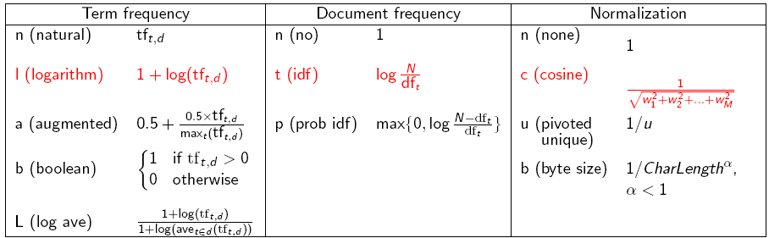
tf-idf weighting has many variants
Sec. 6.4
Notes:
n default is just term frequency
ltc is best known form of weighting

Slide 38
Resources
S. E. Robertson and K. Spärck Jones. 1976. Relevance Weighting of Search Terms. Journal of the American Society for Information Sciences 27(3): 129–146.
C. J. van Rijsbergen. 1979. Information Retrieval. 2nd ed. London: Butterworths, chapter 6. [Most details of math] http://www.dcs.gla.ac.uk/Keith/Preface.html
N. Fuhr. 1992. Probabilistic Models in Information Retrieval. The Computer Journal, 35(3),243–255. [Easiest read, with BNs]
F. Crestani, M. Lalmas, C. J. van Rijsbergen, and I. Campbell. 1998. Is This Document Relevant? … Probably: A Survey of Probabilistic Models in Information Retrieval. ACM Computing Surveys 30(4): 528–552. http://www.acm.org/pubs/citations/journals/surveys/1998-30-4/p528-crestani/
[Adds very little material that isn’t in van Rijsbergen or Fuhr ]

